Slide 1

Tx LLD Module Images
Prepared for Facebook
September, 2020

Slide 2
Figure 1. Module Framework
Strategic Plan & Scope
High Level Network Architecture
Network Design
Deployment
Operations & Maintenance
Field Maintenance
Post-Launch Engineering
Supply Chain Management
Strategy
Business Rules
Service Requirements
Engineering Specifications
Approved Equipment
Site Survey data
Network Design
RAN HLD
RAN LLD
TX Network HLD
TX Network LLD
Civil & Power Design
to Deployment
Mobile Core HLD
Mobile Core LLD
NFVI Dimensioning

Slide 3
Figure 2. Module Functional View
Fundamentals
Inputs
Tx & IP Architecture
Tx HLD Design
RAN LLD Design
Tx Equipment Tech Specs
Outputs
Transport Link Design Principles
IP Protocols Principles
IP Planning Principles
Transport Network LLD Design
Pre-work Tasks
Transport Equipment Selection
Model Site Catalog Definition
Design Tool Selection
IP Planning
Network Design
Bill of Materials (BoM)
Transport Design Tasks
Site Tx Equipment Definition
Transport Link Design
Tx Network Resources Allocation
DF Generation

Slide 4




Figure 3. Typical Transport Network
eNodeBs
Aggregation
Link
Core
External
Networks
Last-mile
Link
UE traffic served by eNodeBs

Slide 5

Figure 4. Transport network scenario based on Carrier Ethernet with L3VPNs
Base Station
Mobile Core
Last-mile
Aggregation
3rd Party
S1
IP
MEF EVC
L3VPN
VLAN-based Service Layer
IP/MPLS
Ethernet
Ethernet
Ethernet
Ethernet
Ethernet PHY
Microwave
Optic Fiber
Optic Fiber + DWDM
Demarcation node
(CSG)
Packet
Node
Packet
Node
Demarcation node

Slide 6

Figure 5. 3GPP Logical Interfaces Protocol Stack
eNodeB1
MME, SGW, etc.
Last-mile
Aggregation
3rd Party
3GPP Logical Interface
3GPP Logical Interface
Upper Layers
Upper Layers
IPv4 / IPv6
IPv4 / IPv6
Any L2
Any L2
Any L1
Any L1

Slide 7
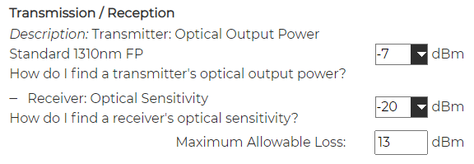
Figure 6. Example of Fiber Optic Equipment Characteristics in Fiber Optic Link Design Tool.

Slide 8
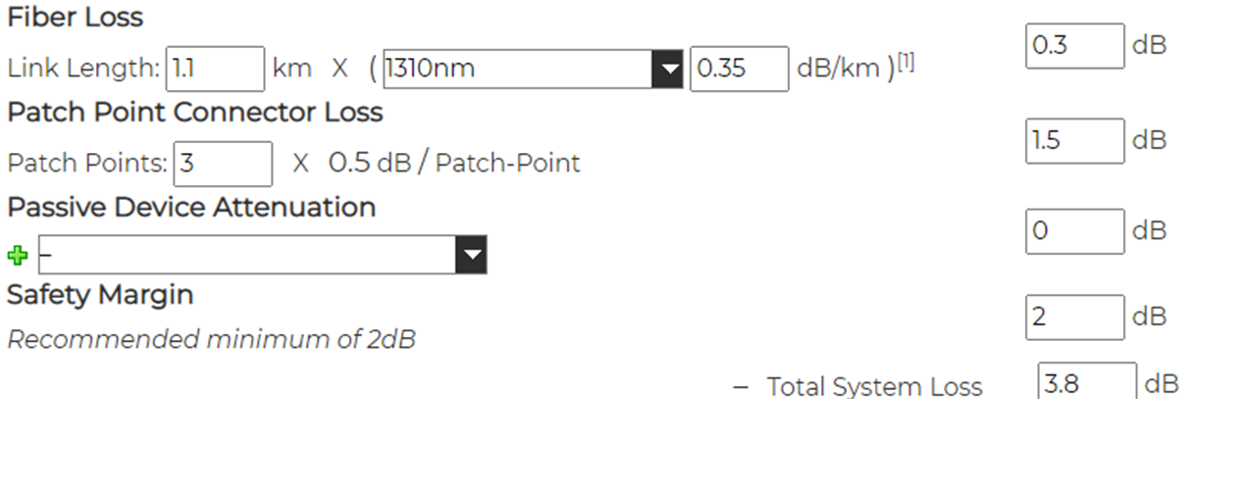
Figure 7. Example of Fiber Losses in Fiber Optic Link Design Tool

Slide 9
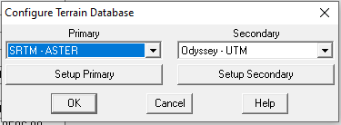
Figure 8. Example of Digital Terrain Database Configuration on MW Link Design Tool

Slide 10
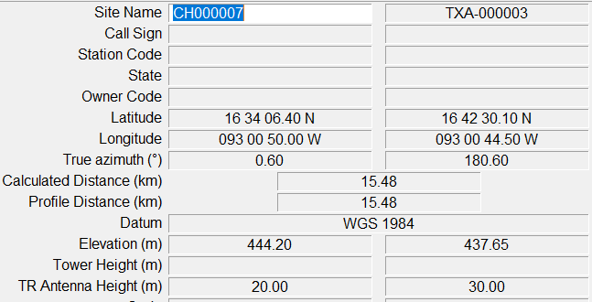
Figure 9. Example of Site Information Configuration on MW Link Design Tool.

Slide 11
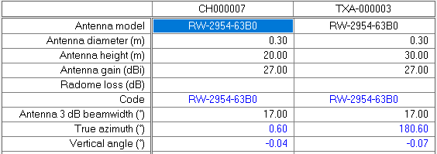
Figure 10. Example of MW Equipment Configuration on MW Link Design Tool.

Slide 12
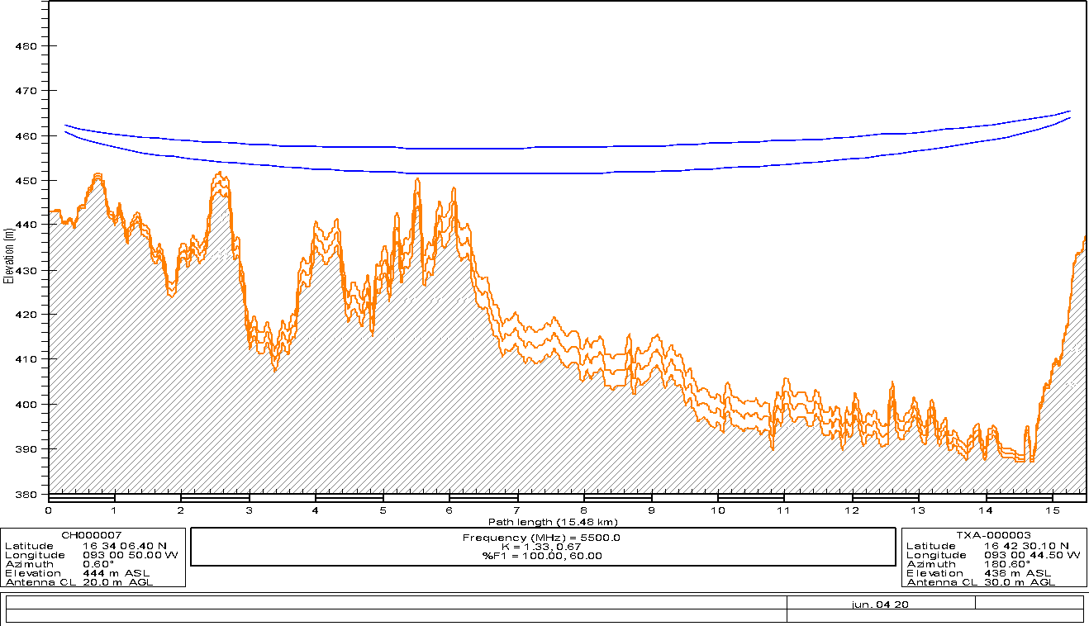
Figure 11. MW Profile Example

Slide 13
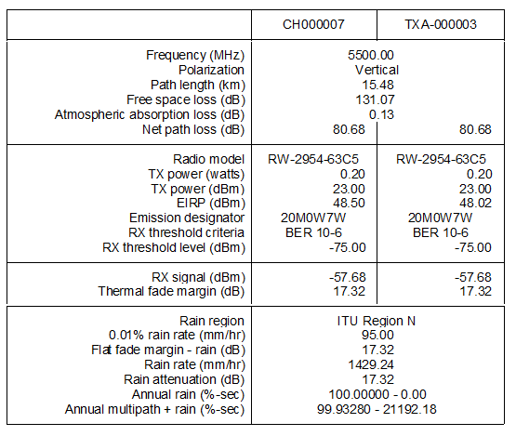
Figure 12. MW Link Report Example

Slide 14
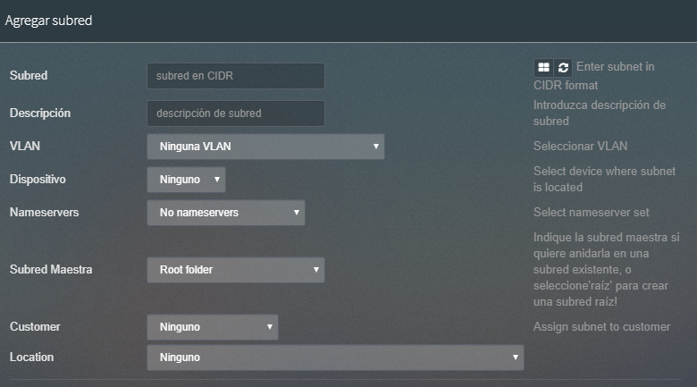
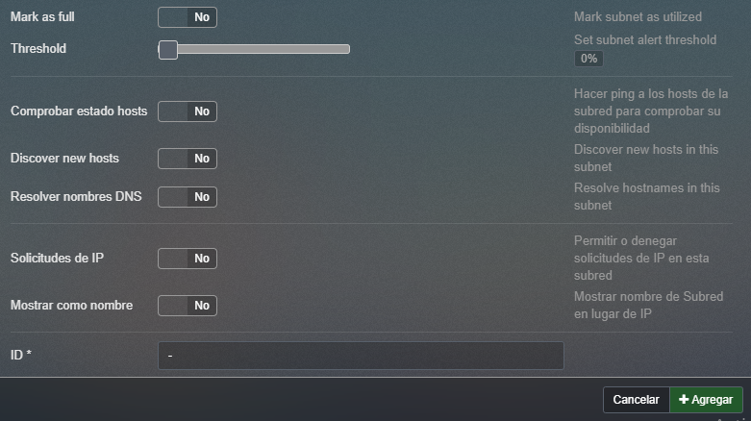
Figure 13. Subnet Allocation Example

Slide 15
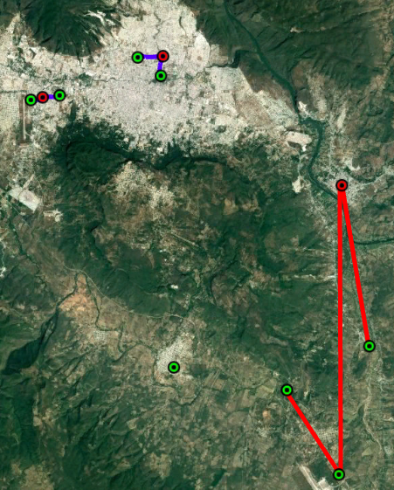
Figure 15. Design Example Scenario
Legend
RAN Nodes
Tx Nodes
Fiber Link
MW Link
Satellite Link

Slide 16
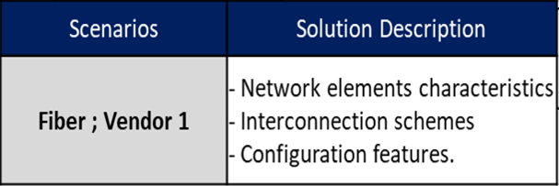
Figure 16. Example of Model Site Catalogue Generation
Scenarios
Fiber ; Vendor 1
Fiber ; Vendor 2
Microwave ; Vendor 1
Microwave ; Vendor 2
Microwave ; Vendor 3
Satellite; Vendor 4
Satellite ; Vendor 5
Technology
Fiber
Microwave
Satellite
Granularity Selection
Scenario Identification
Catalog Generation

Slide 17





Figure 17. Site Topology Scenario for Design Example
MW LINK
ODU
ODU
IF CABLE
IF CABLE
PORT
IF
PORT
IF
PORT
GE0/0/1
PORT
GE0/0/2
PORT
GE0/2/0
Indoor Unit
PORT
1
Macrocell
BBU
UTP CAT6
PORT
0/1
eNodeB Plane | VLAN ID
Control Plane (CP) | 101
User Plane (UP) | 102
Management (OAM) | 103
Synchronization (SYN) | 104
Indoor Unit
AGG ROUTER
3rd ¨PARTY ROUTER

Slide 18

Figure 19. Typical L3 Routing Protocol Implementation
Internet
Core Elements
eNodeB1
Last-mile
Aggregation
3rd Party
L3VPN
Static Routing
IGP (e.g. OSPF)
EGP (e.g. BGP)
Cell Site Router

Slide 19
Figure 20. MW Link Profiles for Design Example
A
B
C

Slide 20
www.telewox.com

